Slide 1
Color Correction for Optical See-Through Displays Using Display Color Profiles
Srikanth Kirshnamachari Sridharan
Dr. Juan David Hincapié-Ramos
Dr. David R. Flatla
Dr. Pourang Irani
Notes:
Good morning
I am Srikanth K Sridharan,
Today I am presenting ,y Master’s thesis Proposal, titled “Solutions To The Colour Mixing Problem Present In See-Through Displays”
Supervised by Dr.Pourang Irani & Co-Supervisor Dr. Juan David Hincapié-Ramos.
I thank you all to be present today for this talk.

Slide 2
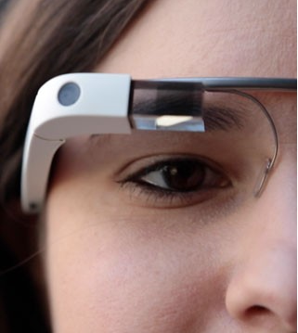
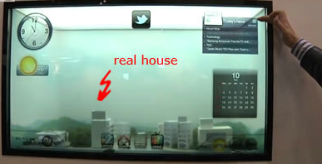
Introduction
Optical see-through displays (OSTD) allow users to view digital content and physical objects simultaneously.
Additive OSTD: Has its own light source
Subtractive OSTD: Filter external light source
Notes:
OSTD are of 2 types
Additive & Subtractive
Advantage of having its own light source enables Additive OSTD to have Hardware's of different form factors such as mobiles, HMD, window based displays!

Slide 3
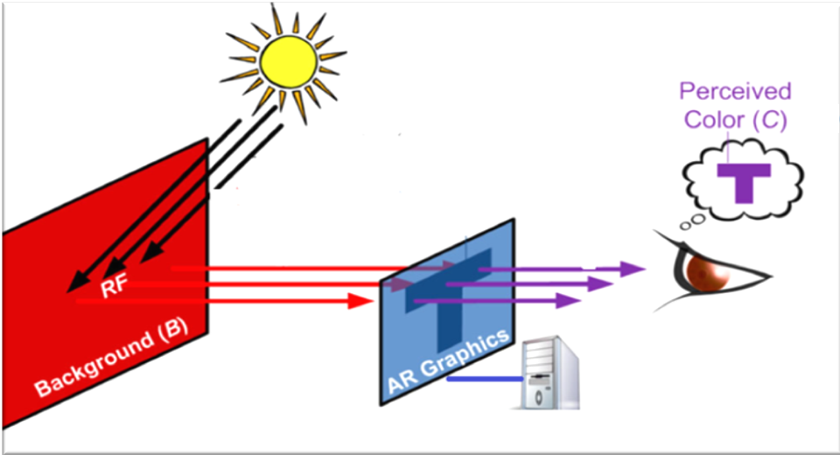
Gabbard et al - More than meets the eye: An engineering study to empirically examine the blending of real and virtual color spaces , VR 2010
Real world background color affects the displayed contents on the digital display
Notes:
However additive OSTD has a problem!
The real world background color belnds with the displayed color.
Color are essential to clarity of the display, colors help humans to clearly understand the contents on the display.
How ever this basic need for a display becomes a challenge with see-through displays, as the content on the screen always affected by the physical background.
This phenomenon cause the users perception of the color being displayed to changes from what the color originally is !

Slide 4
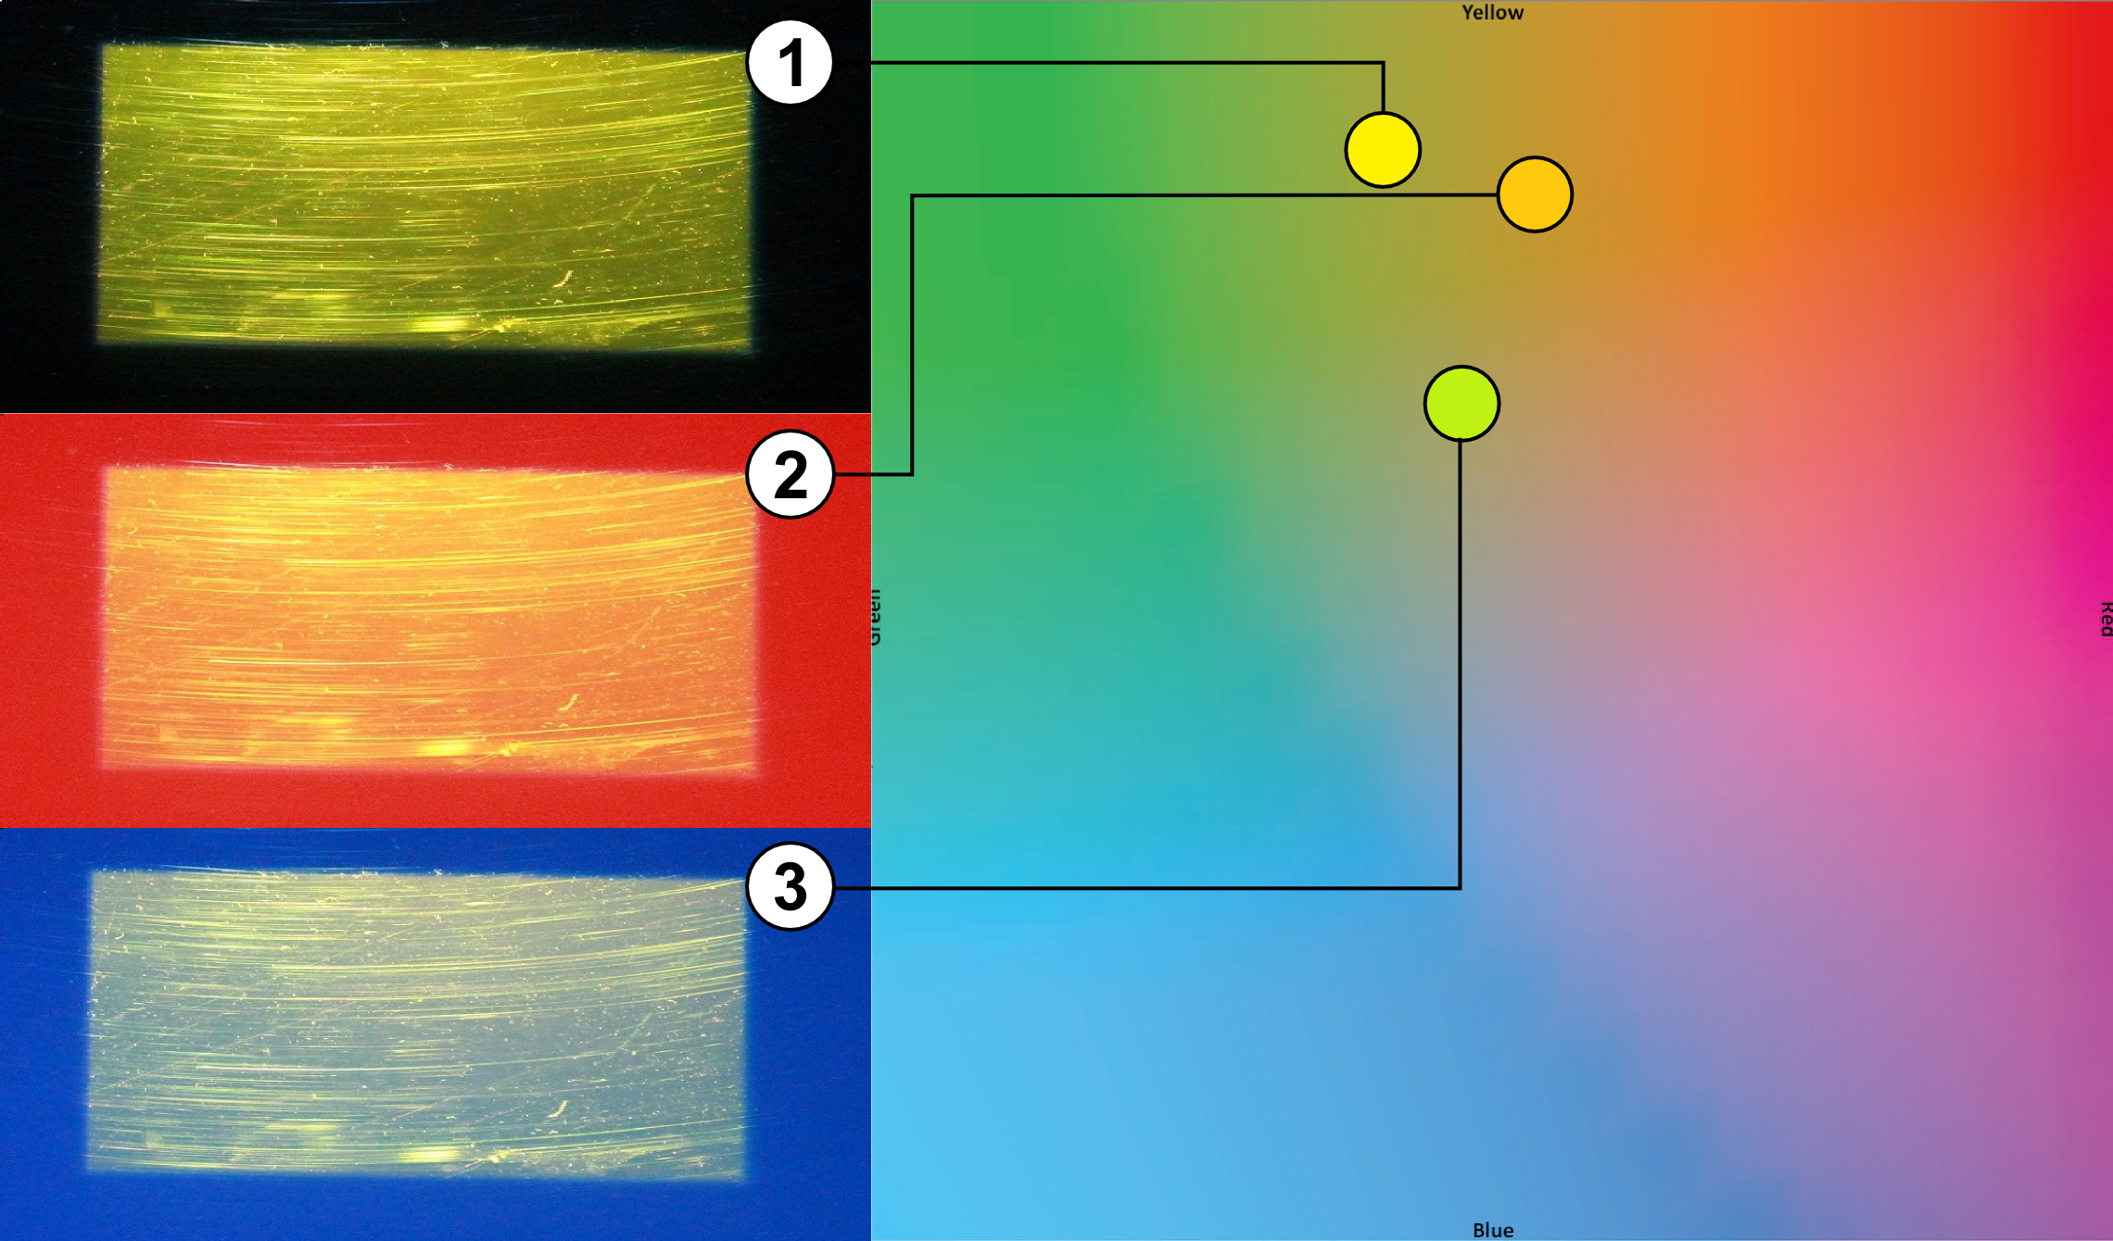
Notes:
So the Problem statement I will be working with is :..

Slide 5
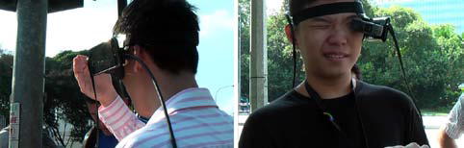
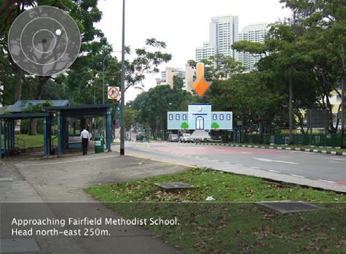
Usability Problem
Kerr et al :Wearable mobile augmented reality: evaluating outdoor
user experience. VRCAI ’11
Notes:
This efforts of background has been studied before by various researchers mostly in the field of Augmented reality.
Steven et al 2011, studies outdoor use of AR system, where they found on heavy influence from the background users used their hand on have a consistent bg to look at the contents !!
Kohei et al 2008, designed a system which shifts the content of a AR system as the background’s color was causing contrast issue.
This shows that this influence of the background is a significant problem

Slide 6
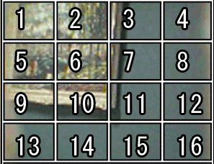
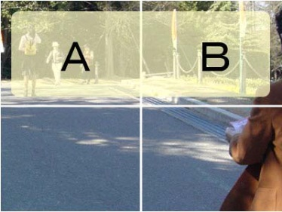
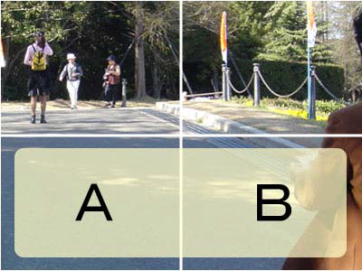
Content Based Solutions
Tanaka et al, An information layout method for an optical see-through head mounted display focusing on the view ability. ISMAR 08

Slide 7
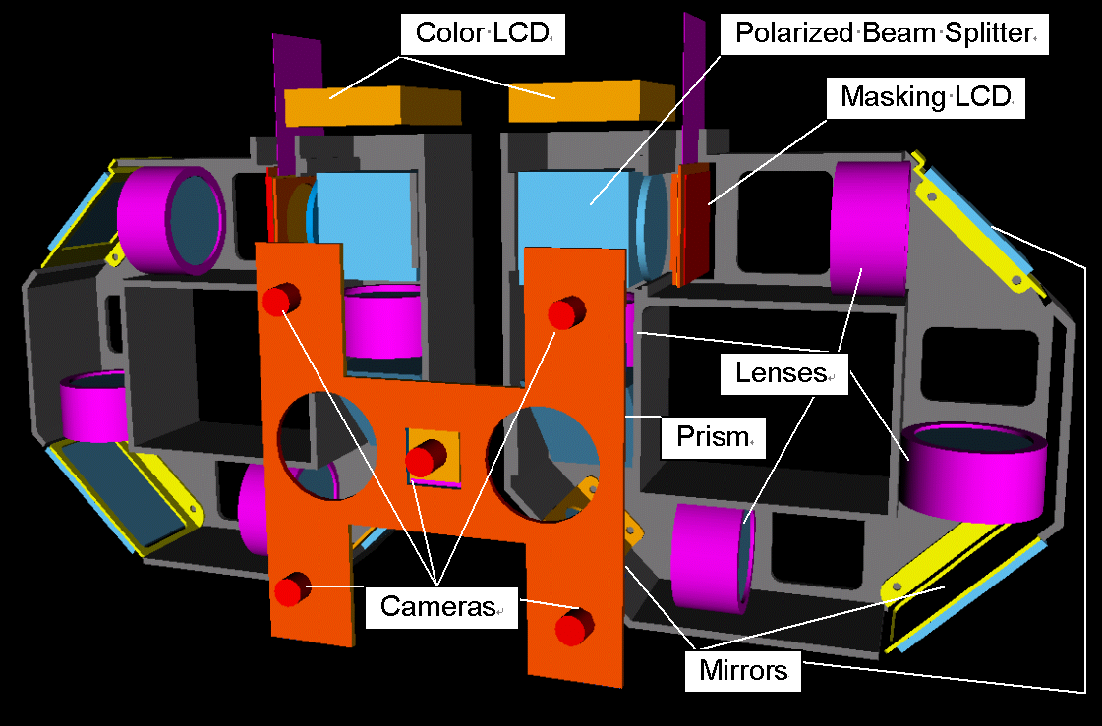
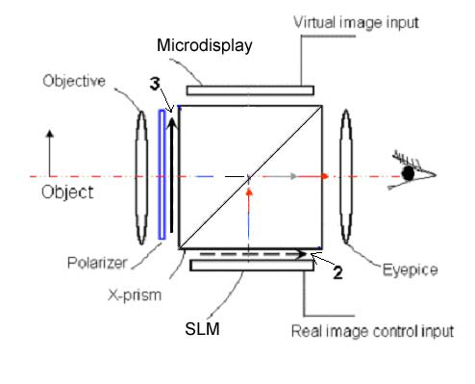
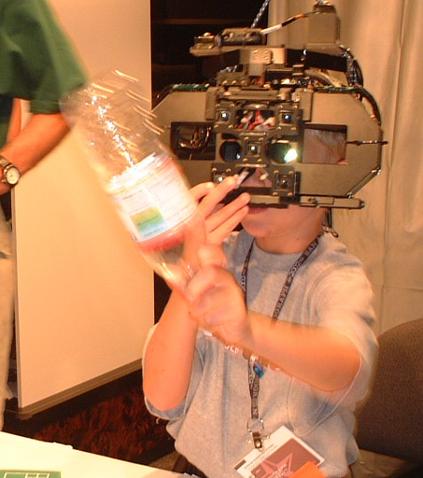
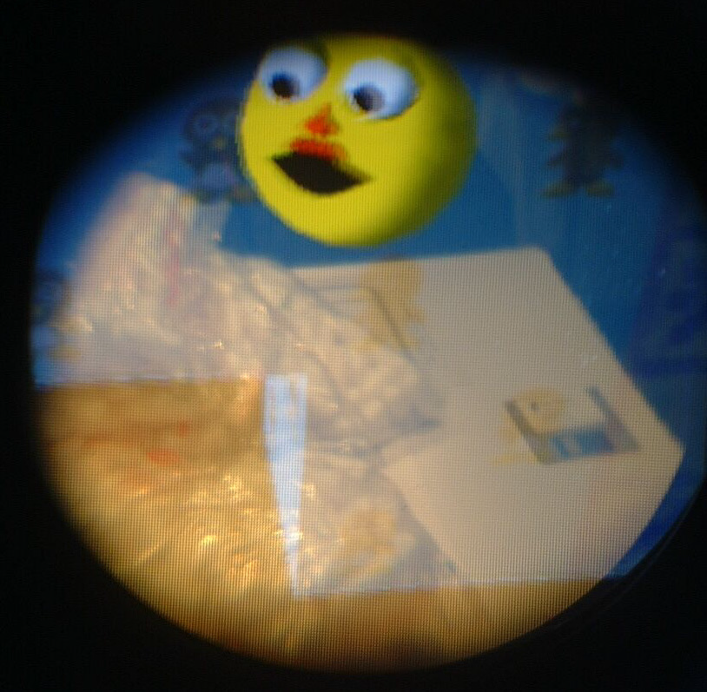
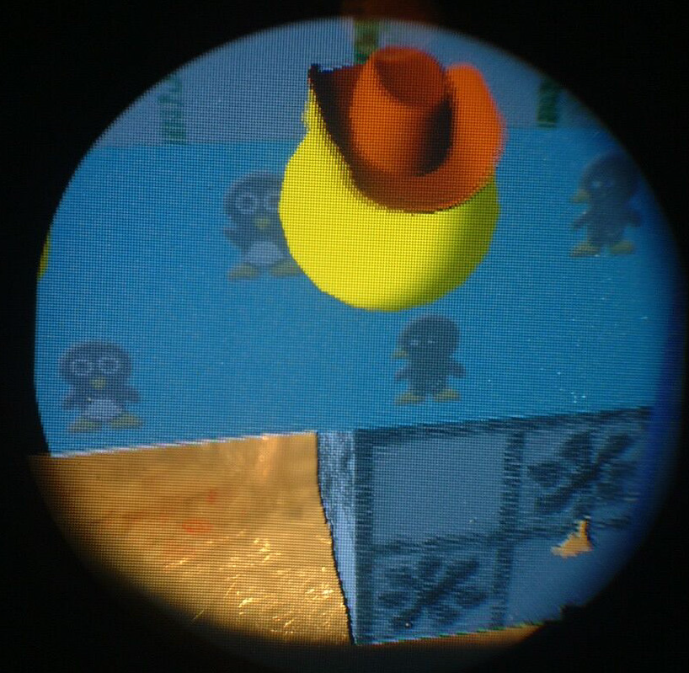
Hardware Based Solution
Kiyokawa et al, An Occlusion-Capable Optical See-through Head Mount Display
for Supporting Co-located Collaboration. ISMAR 2003
Cakmakci et al,
A compact optical see-through head-worn display with occlusion support.
ISMAR 2004

Slide 8
How We differ ?
We aim not to change the location of UI elements
or
Add new hardware components
we wanted to manipulate the color shown by the display; an approach known as Color Correction.

Slide 9
Color Correction
Involves in the system finding an alternative digital color which, upon blending with the background comes closest to the desired digital color

Slide 10
Background
To pick a alternate color we need ability to predict how colors blend on a given display.
We propose a new color blending model that can predict how colors blend on a OSTD

Slide 11
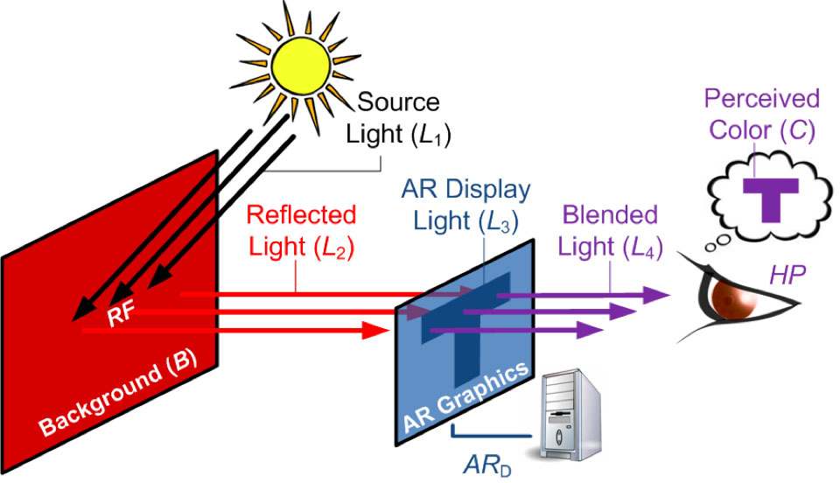
Color Blending
Color blending is the phenomenon where two colors mix to form a third.
Gabbard et al.[2010], studied such color changes in OSTD by building an experimental test-bed

Slide 12
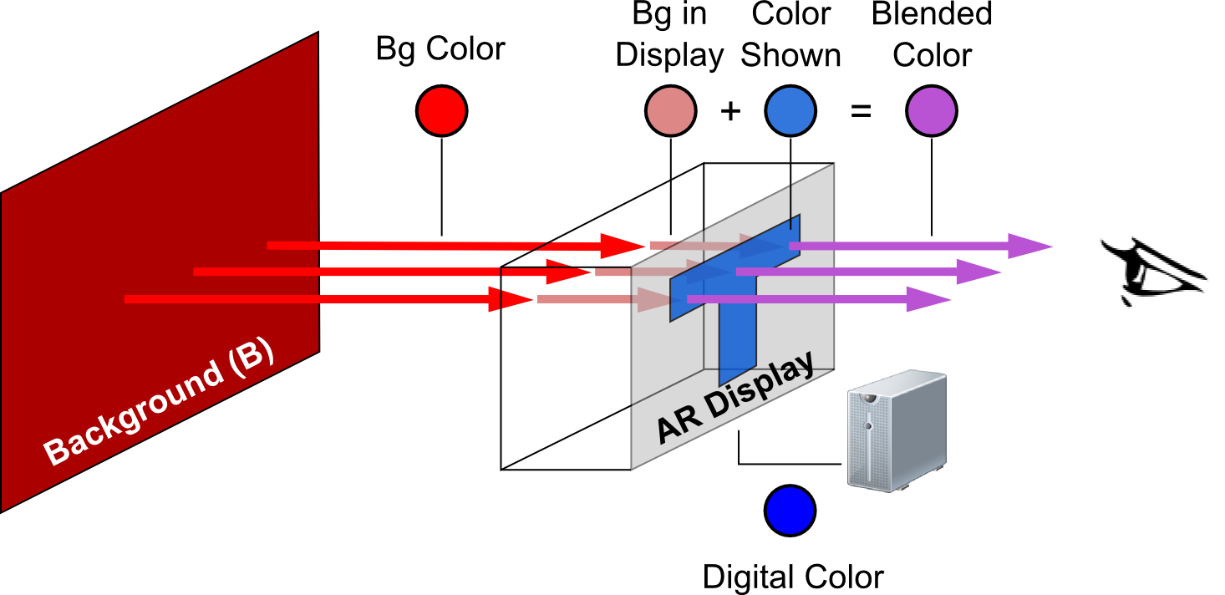
Color Blending Model
We created a new Color Blending model
It is based on Two distortions functions:
Render Distortion
Material Distortion
Blended Color = frender(Digital Color) + fmaterial(Bg Color)

Slide 13
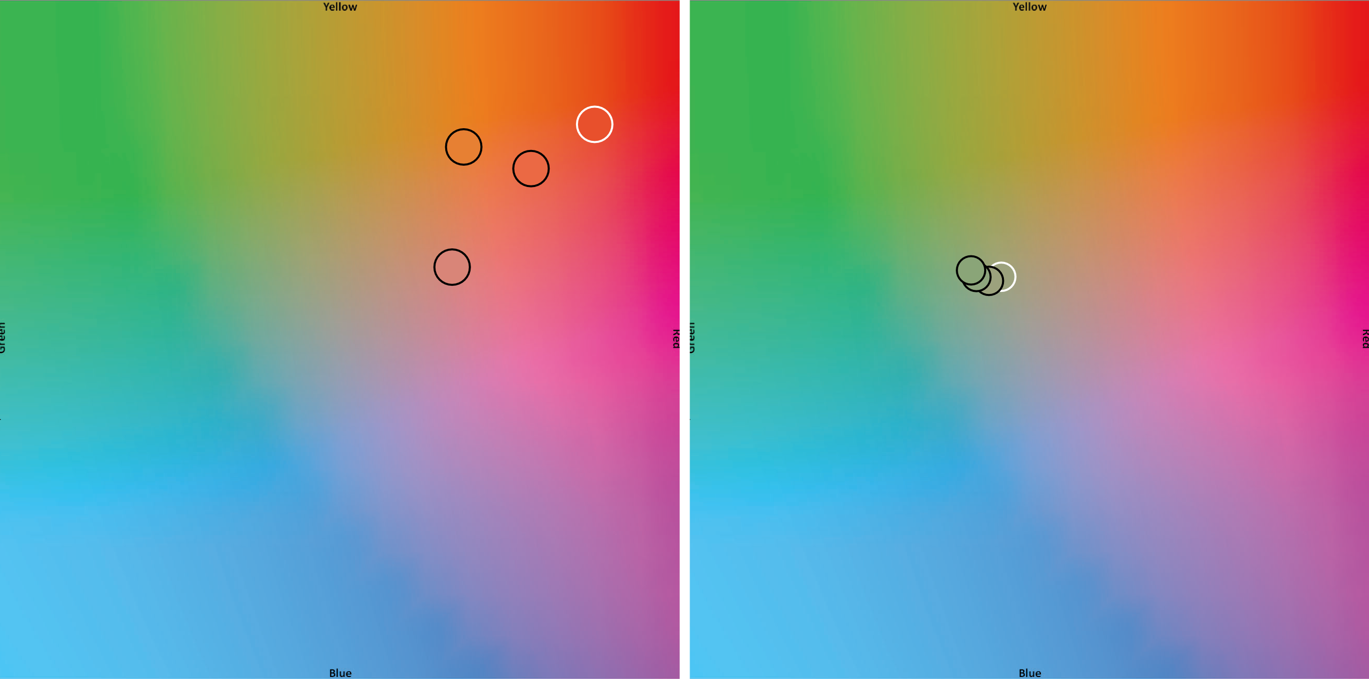
Color Blending Model
Foreground Colors
Background Colors
Render Distortion Function
Material Distortion Function

Slide 14
Contribution
A new Color blending Model for OSTD
Introduce Binned Profile (BP) – To handle Render Distortion
BP Method-Color Blending Model Based on BP
BP Based Color Correction

Slide 15
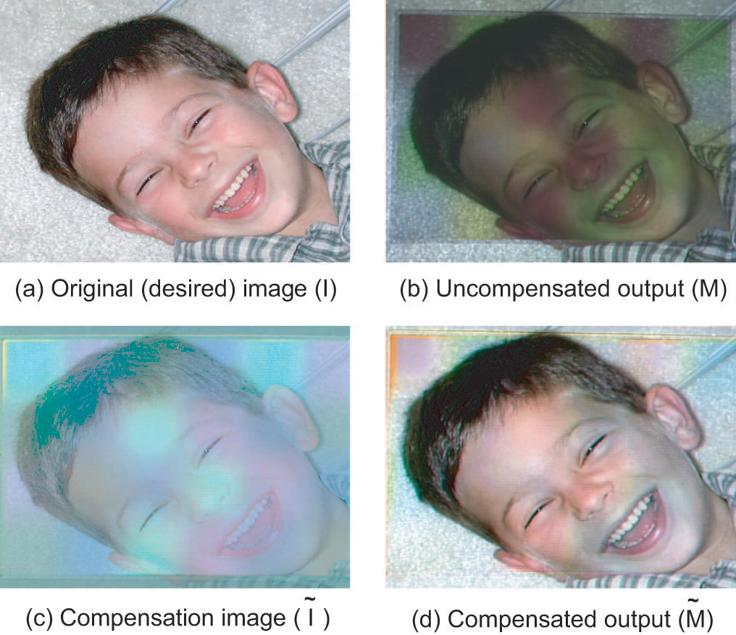
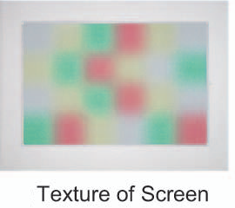
Color Correction
Nayar et al, A projection system with radiometric
compensation for screen imperfections 2003

Slide 16
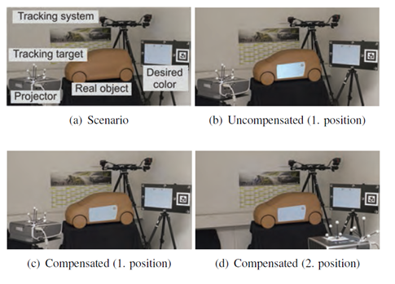
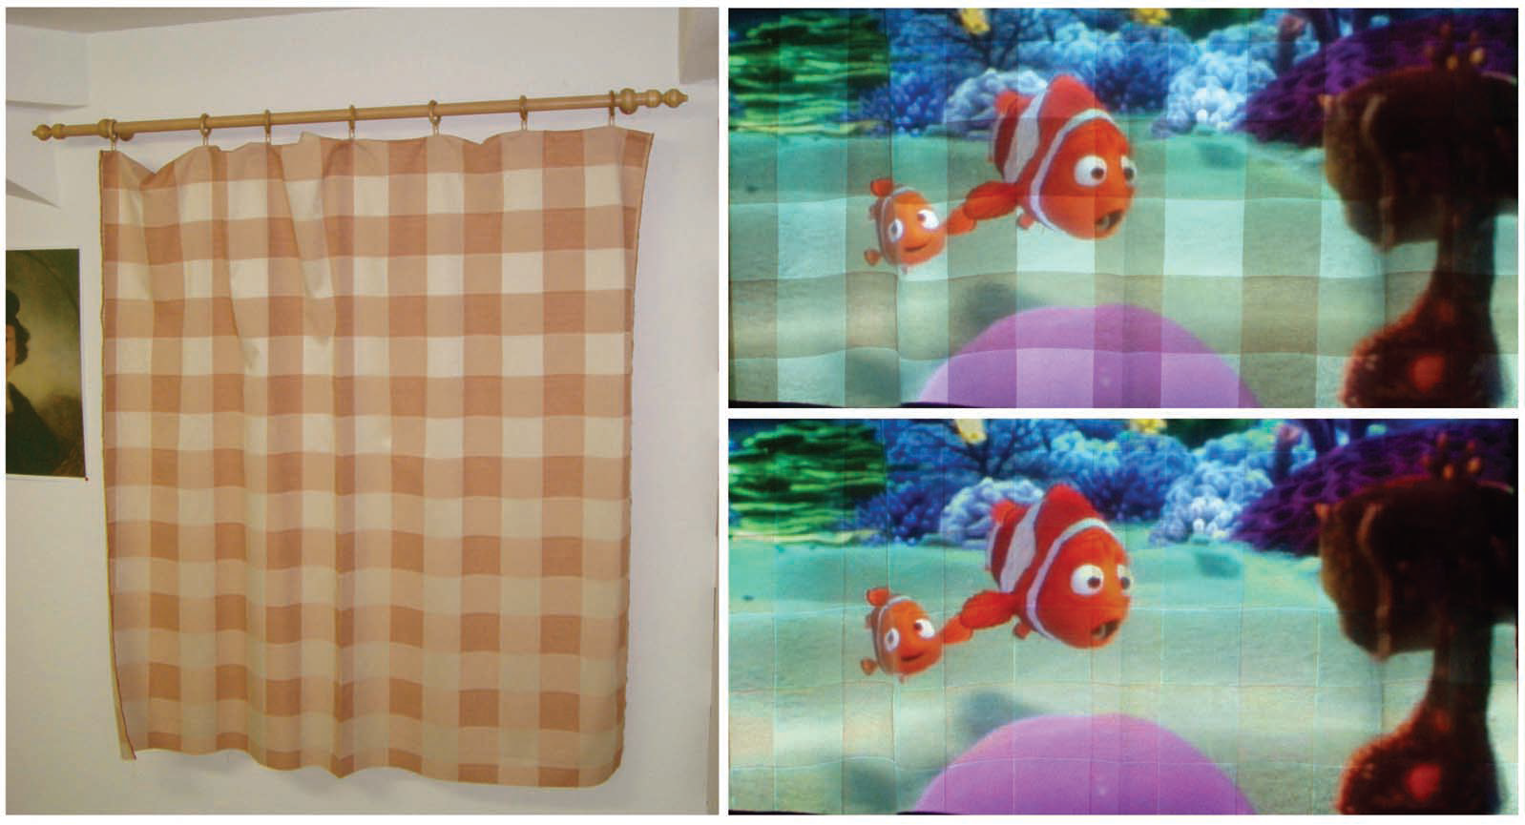
Existing Works on Color Correction
Bimber et al Embedded entertainment with smart projectors.2005
Menk et al, Interactive visualization technique for truthful color reproduction in spatial augmented reality applications. ISMAR 2011
Notes:
Color correction in projector are a close related area which also deals with real world color affecting the digital.
1) This work was the base line for previously shown work by Weiland .
2)Work deals with projecting on to a physical display.

Slide 17
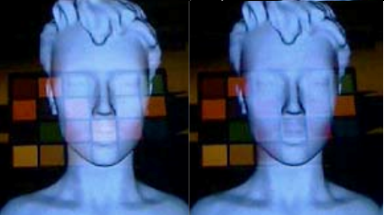
Color Correction in OSTD
Weiland et al, Colorimetric and photometric compensation for optical see-through displays.

Slide 18
Background
Colors
Color Spaces

Slide 19
Approach
Core system design
Color predicting model
Color correction algorithm

Slide 20
Core System Design
System
Color Prediction Model
Background and Digital Color feeder
Corrected Digital Color
Color-Correction Algorithm
Notes:
The systems consists of
Model
Algorithm
The system takes in input as bg and digital color , the model predicts the mixture based on which the algorithm corrects the color. Which is the output which will be displayed on the screen.

Slide 21
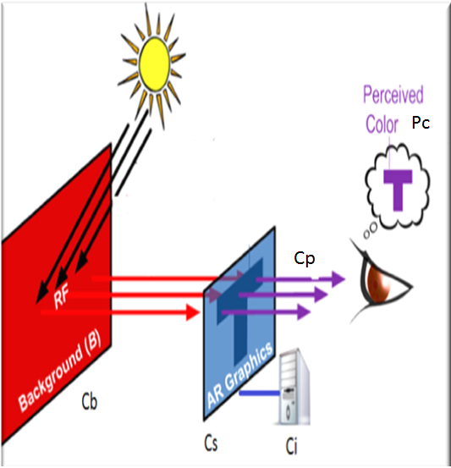
Naming Terminologies
Cb- Physical backgrounds color
Ci- Color intended to be shown by the computer
Cs- Color seen by the user with black background (or no background)
Pc- Is the color perceived by the user from the screen
Cp- Predicted color mixture
Notes:
Explain in detail the slide

Slide 22
Color Prediction Model
I propose three models
Direct model
CAT dependent model
Gamut mapping model

Slide 23
1. Direct Model
If,
A = color 1, B = color 2 and C = Color mixture
By basic color physics,
XYZ C= XYZ A + XYZ B
Where ,
X C=X A + X B
Y C=Y A + Y B
Z C=Z A + Z B
Notes:
Its named Direct model as it provides a direct solution.
Explain as given on the slide !

Slide 24
Direct Color Prediction Model
known:
Background’s (Cb) XYZ
Digital Color’s (Ci) XYZ
To find / predict:
The resultant Mixed Color (Cp).

Slide 25
Direct Color Prediction Model
Real world Background
Text
Cb Ci Cp
Notes:
Explain the slide as per the animation order!!
Ie)
We know the Bg
We know the Ci ( color the computer wants to show)
Add these two colors linearly and give the predicted color mixture!

Slide 26
2. CAT Dependent Color Prediction Model
Here we cannot assume
Digital color intended Ci = Cs Digital color seen
Need to find Cs-Ci relation
Notes:
Based on the previous image
we cannot assume
Digital color intended Ci=Cs Digital color seen
So there is indispensable need to find the relation between Ci and Cs

Slide 27

Chromatic Adaptation Transform (CAT)
Shows how one color in a particular illuminant looks when its under a different illuminant.
Pictures from Lindbloom website
Notes:
Is a popular method which is provides a transformation matrix to show how a particular color looks in different lighting
As seen in the image.
This can be used to predict how the display will show a particular color

Slide 28
CAT Dependent Model
Ci Cs
Text
Cb Ccat Cp
*Ccat- CAT transformed Ci
Notes:
Explain as per the animation
We know the Bg
We know how Computer wants the show the color
We know it doesn look the same as we want to show
Use cat by knowing the white point of the display to predict how Ci will look in the screen
Use this Cat transformed Ci to add with the Bg to predict the Cp

Slide 29
3. Gamut Mapping Model
Different see-through devices might have different gamut of displayable colors
Map sRGB – CustomRGB
Then use the custom gamut to predict the mixed color
Notes:
Read out the first point
So there is a need to know how each color the Computer wants to show ill be shown in the display.
Using a precise device like a colorimeter we can map each color in a stnd gamut like sRGB to the a custom gamut based on how the display shows the color,

Slide 30
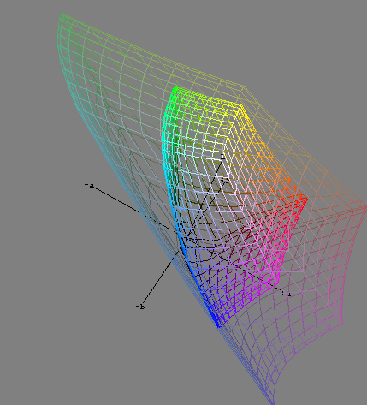
Pictures from Lindbloom’s website
Notes:
It might look some thing like this , but not exactly like this , this is just a descriptive example.
Where we know each color in one space and its corresponding representation in the custom space

Slide 31
Gamut Mapping Model
Ci Cs
Text
Cb GMc Cp
*GMc-Gamut mapped Ci
Notes:
First show that how system wants to show the color
And how its mapped to a custom gamut ,where each color is indexed to its source in sRGB
Once we know what Ci is , we look up in this table where it can give the corresponding RGB in custom space ,
Then on know this and the BG we can find Cp.

Slide 32
Color Correction Algorithm
Uses the model’s output predicted color
Adjusts the digital color such that
The new mixed color = Digital color intended
Cp = Ci
Notes:
Once we know how the color will be shown , we gain control over the display which we previously lacked.
Now we can choose do with the display as we chose to.
We can adjust the color in the display in such a way that when the color addition does happen we get to see the resultant color as the color we intend to show !

Slide 33
Evaluation
Model Evaluation
Algorithm Evaluation
System Evaluation
Notes:
I intend to do user studies to verify my model’s color prediction and algorithms acuratenes

Slide 34
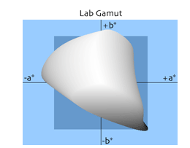
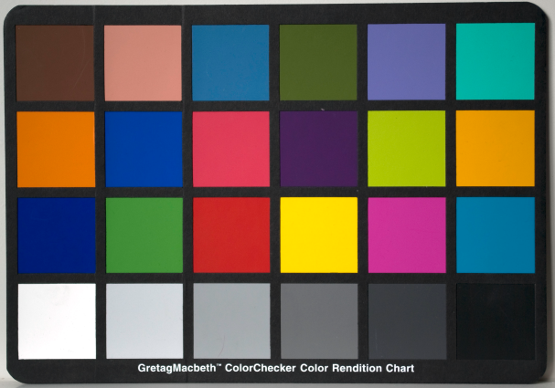
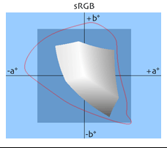
Colors for experiment
24 Macbeth Chart colors as background colors
33000 perceptually uniform RGB colors
Pictures from Lindbloom website and wikipedia
Notes:
These are the colors which I will be using in my evaluations

Slide 35
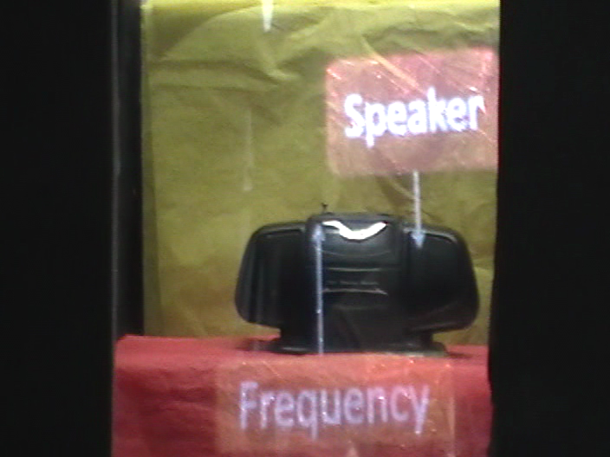
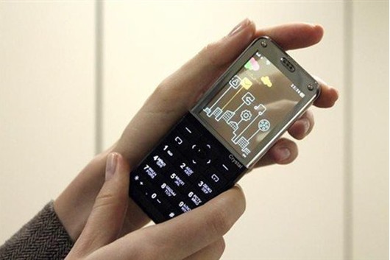
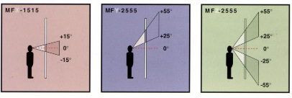
Hardware
Lenovo S-800
Lumisty Sheet
Notes:
Lumist and Lenovo S-800 phone with transparent OLED

Slide 36
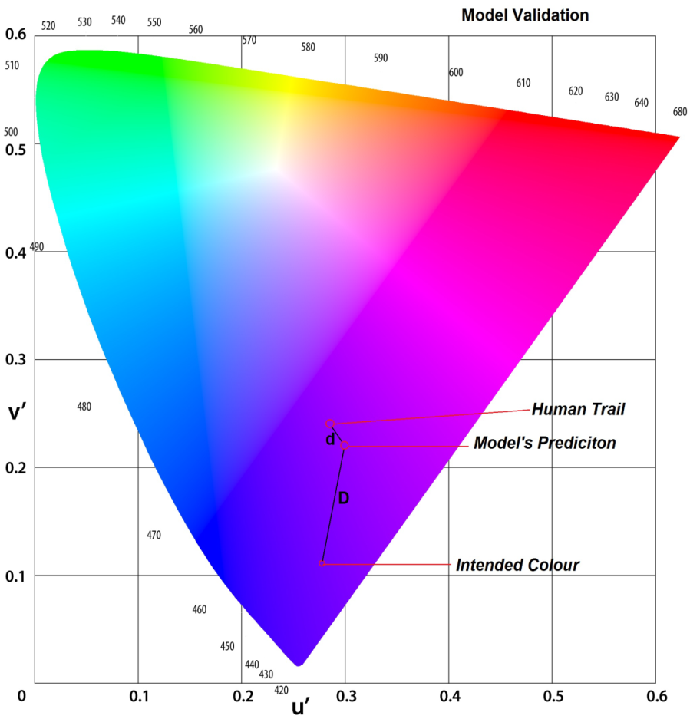
Model
The Euclidian distance between the model's predicted color(Cp) and the color perceived by the user (Pc) : ’d’
‘d’=Δ| Cp - Pc|
The Euclidian distance between the intended colour (Ci) and the user predicted color (Cp) : ’D’
‘D’=Δ| Cp - Ci|
Hypothesis:
‘d ‘< ‘D’
Smaller the value of ‘d’
higher the accuracy of the model
Notes:
Explain just wats in the slide using the pic

Slide 37
Model Validation
Change in a (Lab)
Change in L (Lab)
+ Key
Change in b(Lab)
- Key
Notes:
Explain this is how the users would see and choose ,.. So that we can arrive at d and D

Slide 38
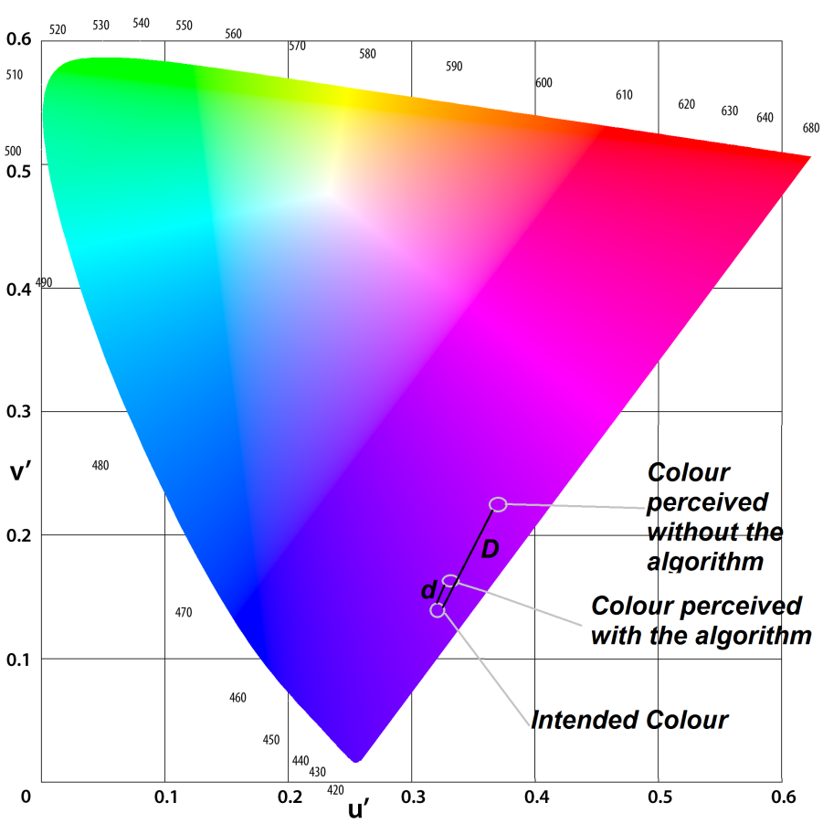
Algorithm
The Euclidian distance between the color intended(Ci) and the color perceived by the user (Cp) : ’d’ (with correction algorithm)
‘d’=Δ|Cp - Ci|
The Euclidian distance between the color intended(Ci) and the color perceived by the user (Cp) : ’D’ (without correction algorithm)
‘D’=Δ|Cp - Ci|
Hypothesis:
‘d ‘< ‘D’
Smaller the value of ‘d’
higher the accuracy of the algorithm
Notes:
Explain just wats in the slide using the pic

Slide 39
Algorithm Validation
Change in hue
Change in saturation
+ Key
- Key
Notes:
Explain this is how the users would see and choose ,.. So that we can arrive at d and D

Slide 40
System Validation
Without color correction
With color correction
Notes:
Once the algo and model are verfy I also intend to test the system ,. !

Slide 41
Possible Extension
Color fidelity
Contrast preservation

Slide 42
Color fidelity
Without color correction
Text to read
With color correction
Text to read

Slide 43
Contrast
Without color correction
Text to read
With color correction
Text to read

Slide 44
Summary
I propose on a see-through display:
A model to predict the digital color’s shift
A color rendering algorithm which will correct the display
A system which will preserve the color displayed on the display as the designer intended

Slide 45
Thank you, Questions
Presented by,
Srikanth Kirshnamachari Sridharan

Slide 46
Annexure

Slide 47
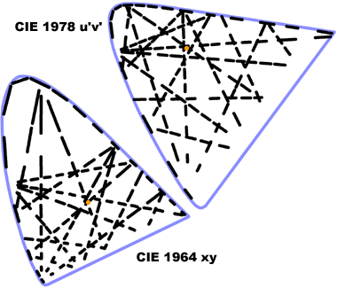
Just Noticeable Difference
Notes:
JND is the Euclidian distance between 2 given color in a color space with in which the colors appear same to humans.
In XYZ space it varies with each color, but in uniform spaces like LAB and LUV its constant number ( 2.5 in lab).

Slide 48
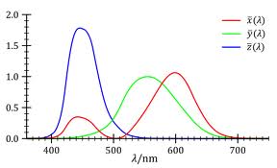
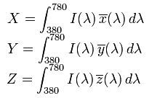
XYZ
Pictures from wikipedia

Slide 49
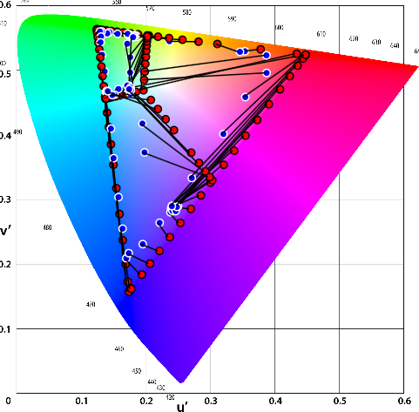
Problem Foreseen in Direct Color
Digital Color Intended (red) Digital Color Seen (Blue) relation on the See-through screen
Notes:
Explain why this might not work
As seen in the fig , which is a primitive data collected using a ordinary wen cam , there is a clear color difference between the color computer wants to show(red) and the color seen in the screen (blue)
This can be due to various factor:
Bad camera data
or
Display capability of the device

Slide 50
Rational behind using Direct model
The predicted color will also be published on the same screen.
Can calibrate the display to produce the color as needed.
This factor is dependent on the hardware

Slide 51
Variables
Independent :
Model
colours on the see-through screen ( random 20 per user from 33000).
colours on the background (24).
Dependent:
the user's perception of the colour
Controlled :
brightness of the projected colour,
luminosity of the back-ground,
Distance between the user and the display device.

Slide 52
Variables
Independent :
Algorithm.
colours on the see-through screen ( sample 20 per user from 33000).
colours on the background (24).
Dependent:
the user's perception of the colour
Controlled :
brightness of the projected colour,
luminosity of the back-ground,
Distance between the user and the display device.

Slide 53
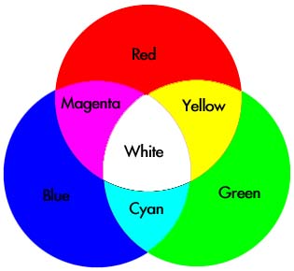
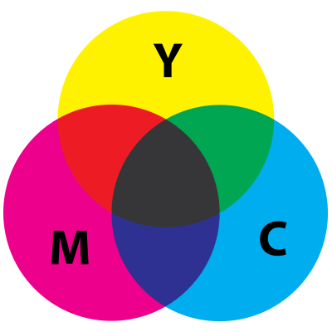
Colors
Power Vs Wavelength
Each wavelength is a color
Pictures from Wikipedia
Notes:
Just explain what's given the slid
Colors=Power Vs Wavelength
And it works in addictive and subtractive way !

Slide 54
Color Spaces
Color space is an abstract mathematical model to represent and reproduce colors
CIE (International Commission on Illumination)
Basic: XYZ (1936)
Uniform: LAB, LUV (1976)
Digital: RGB
Notes:
Read the first sentence out loud ,.. And say
Color is a abstract concept , its just what human eyes can pick up form the electromagnetic spectrum. In order to quantify it , human subject are needed.
There are different color spaces as given in the slide

Slide 55
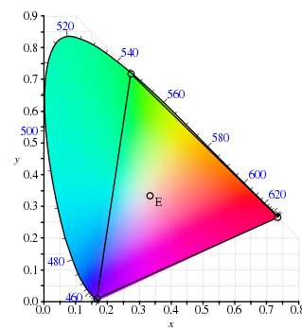
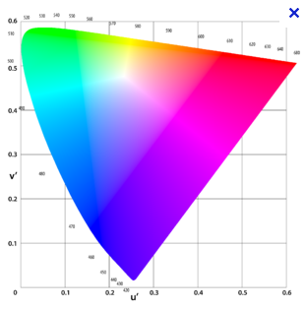
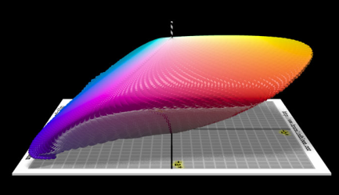
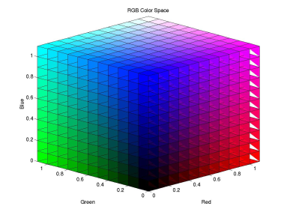
Spaces Derivation
XYZ
LUV
LAB
sRGB
Pictures from Lindbloom’s website and wikipedia
Notes:
Juan , is this slide needed ?? Or just above two is enough??

